Slide 1


Retail Analysis
Retail analysis is the process of providing analytical data on inventory levels, supply chain movement, consumer demand, sales, etc. that are crucial for making marketing, and procurement decisions. The analytics on demand and supply data can be used for maintaining procurement levels and also for making marketing decisions. Retail analytics gives us detailed customer insights along with insights into the business and processes of the organisation with scope and need for improvement
sales analysis is a structured review of your company’s sales data. A thorough analysis can reveal what’s working and what isn’t, and bring opportunities for improvement into clearer focus. For example, it can tell you which sales channels are delivering the most ROI, what factors are impacting conversion rates, and can help you determine your customer acquisition costs.
Customer analysis is collecting and analyzing customer information to gain insights into their needs, preferences, behaviours, and characteristics. Customer analysis typically involves collecting data from various sources, such as surveys, interviews, focus groups, sales data, and social media analytics. This data is used to identify patterns and trends in customer behaviour, such as purchasing habits, product usage, and brand loyalty
Market analysis is a comprehensive study of a specific market within an industry, including an examination of its various components, such as market size, key success factors, distribution channels, target audience, profitability and growth rate, and market trends
Product analysis is the process of gathering, defining, and analyzing data about a product or service to make better decisions. Product analysis involves examining product features, costs, availability, quality, appearance and other aspects. Product analysis is conducted by potential buyers, by product managers by attempting to understand competitors and by third-party reviewers.
Financial analysis is the process of evaluating businesses, projects, budgets, and other finance-related transactions to determine their performance and suitability. Typically, financial analysis is used to analyze whether an entity is stable, solvent, liquid, or profitable enough to warrant a monetary investment
Sales Analysis
Customer Analysis
Market Analysis
Product Analysis
Financial Analysis

Slide 2
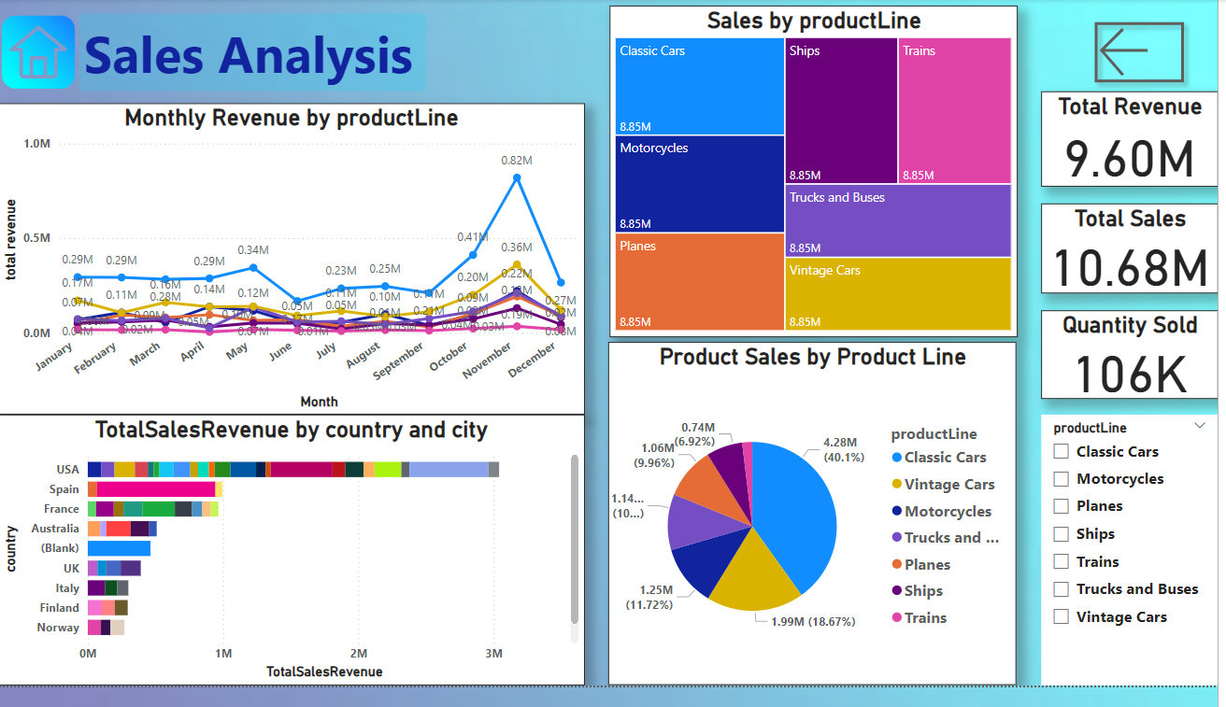


Slide 3
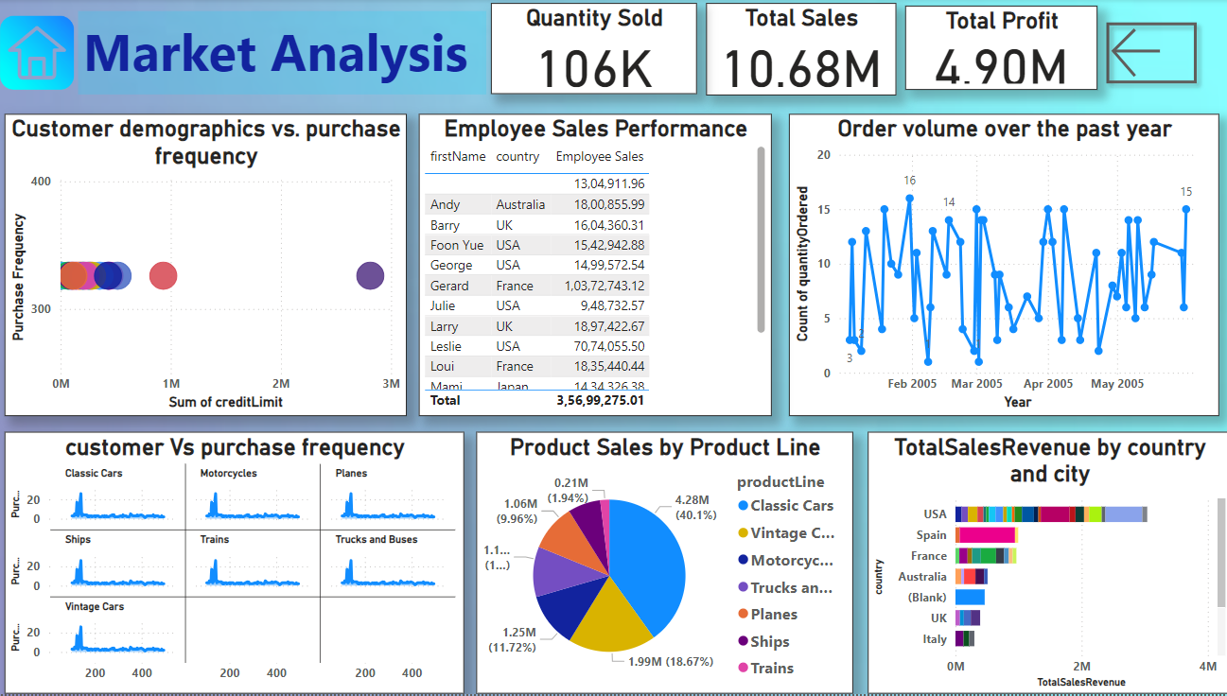
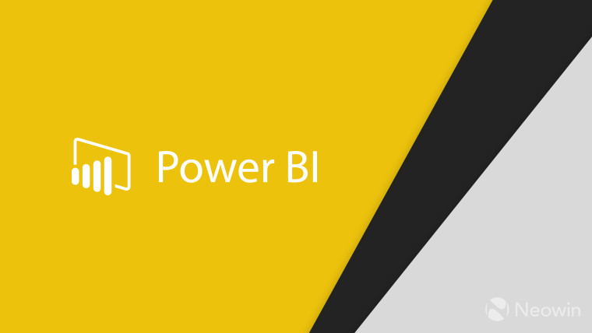
Retail Analysis :

Slide 4
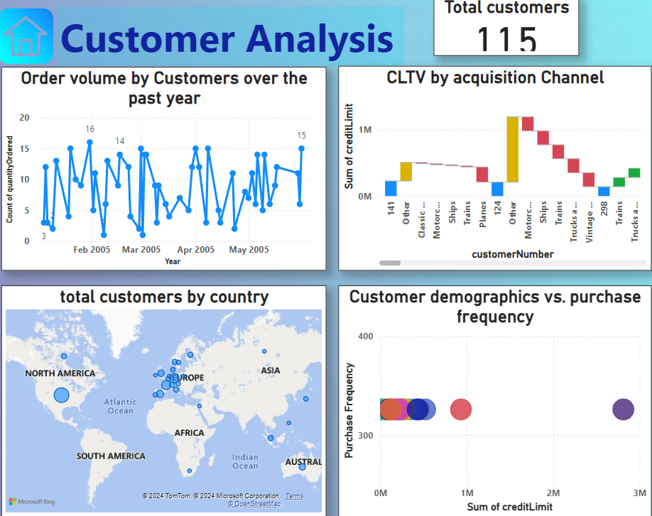

Slide 5
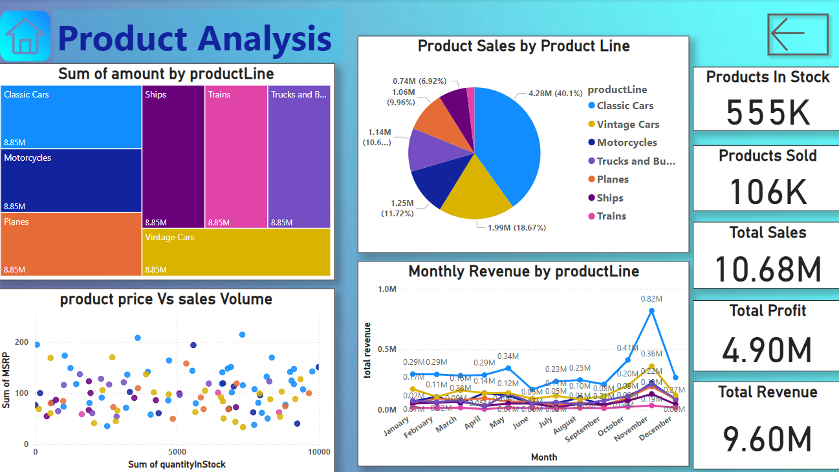

Slide 6
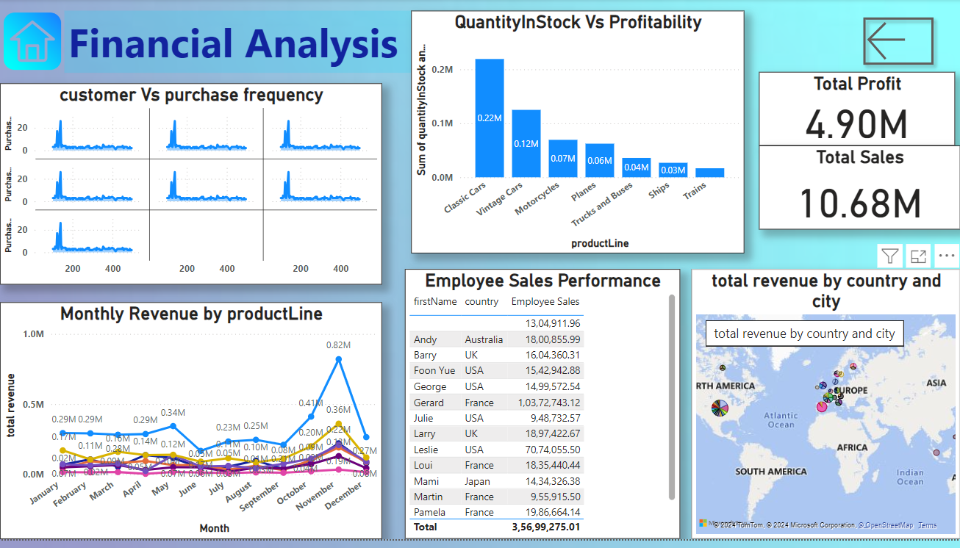
Retail Analysis :

